Slide 1
Packet Switching
COM1337/3501
Textbook: Computer Networks: A Systems Approach,
L. Peterson, B. Davie, Morgan Kaufmann
Chapter 3.
Notes:
Review of Direct Link Networks. Should have seen them in COM3510.
Focus on results and practical considerations and not on how they were obtained.

Slide 2
Outline
Packet switching paradigms
Bridges and extended LANs
Cell switching
Switching hardware

Slide 3
Scalable Networks
Switch
  forwards packets from input port to output port
  port selected based on address in packet header
Advantages
  cover large geographic area (tolerate latency)
  support large numbers of hosts (scalable bandwidth)
T3
T3
T3
Switch
T3
STS-1
STS-1
Input
Output
ports
ports
Notes:
Limitation in number of input/output ports doesn’t mean that we cannot build large networks. Interconnection of switches allows to connect a large number of hosts.
Ethernet like networks do not scale to large distances. Switches can be connected by point-to-point links thus providing large geographic scope.
Adding new hosts doesn’t necessarily reduce the performance of other nodes.

Slide 4
Packet Switching Paradigms
Virtual circuit switching (routing)
Datagram switching (routing)
Source routing

Slide 5
Source Routing
The information to route the packet is provided by the source host and included in the packet
Example of implementing source routing:
  Assign a number to each switch output port
  Include the list of output ports that the packet has to go through
  The list is rotated by the intermediate switches before forwarding
Disadvantage:
  Packet initiators need to have a sufficient information about the network topology
  The header has a variable length
Notes:
What techniques can be used to communicate between hosts in a switched network:
Source routing (could be used in some IP routing and in some cases in wireless ad hoc networks)
Virtual Circuit or connection-oriented approach.
Datagram approach or connectionless approach.
Instead of rotation, use a pointer
Used in the IP, loose source routing, wireless, connection setup

Slide 6
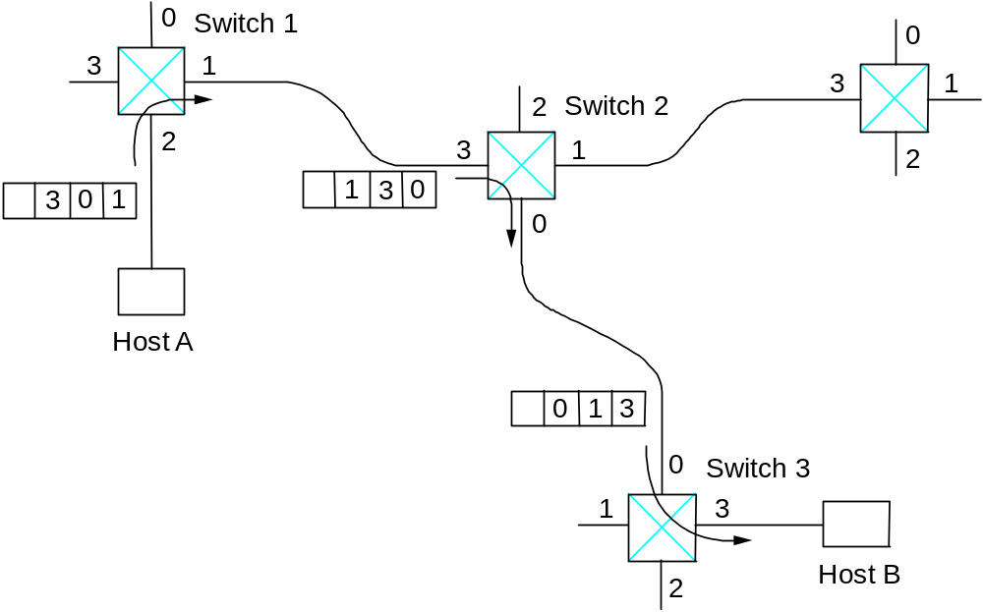
Source Routing

Slide 7
Virtual Circuit (VC) Switching
Explicit connection setup (and tear-down) phase
Subsequent packets follow same circuit (path)
Sometimes called connection-oriented model
0
Switch 1
3
1
2
Switch 2
2
3
1
5
11
Analogy: phone call
Each switch maintains a VC table
0
Host A
7
0
Switch 3
1
3
4
Host B
2

Slide 8
Virtual Circuit Switching
Connection Setup approaches:
  Permanent Virtual Circuits (PVC): manually setup/removed by network administrators
  Switched Virtual Circuits (SVC): dynamically setup through signaling over some control channels
Connection state => VC table
  incoming interface, VC Identifier (VCI), outgoing interface, outgoing VCI
SVC:
  The setup message is forwarded over the network
  New entries are created in the VC table and destination switches choose incoming VCI
  When the setup message reaches the destination, connection acknowledgements and chosen VCI are communicated back to the source
Notes:
Connection setup: to establish a connection state at intermediate switches

Slide 9
Virtual Circuits
Examples of Virtual Circuit Technology:
  Frame Relay, X.25, Asynchronous Transfer Mode (ATM)
Frame Relay was popular for creating virtual private networks (VPNs) using PVC.
ATM is a more complex technology that provides mechanisms for supporting quality of service
Notes:
Quality of service: throughput, congestion avoidance

Slide 10
Datagram Switching
No connection setup phase
Each packet forwarded independently
Sometimes called connectionless model
Host D
Analogy: postal system
Each switch maintains a forwarding (routing) table
0
Switch 1
Host E
3
1
Switch 4
Host C
2
Switch 2
2
3
1
0
Host A
Host G
0
Switch 3
1
3
2
Host H

Slide 11
Virtual Circuit Model
Setup: Typically wait full RTT for connection setup before sending first data packet.
Header: While the connection request contains the full destination address, each data packet contains only a small identifier, making the per-packet header overhead small.
Quality of Service (QoS):
  Connection setup allows resource reservation
  If a switch or a link in a connection fails, the connection is broken and a new one needs to be established.

Slide 12
Datagram Model
Setup: There is no round trip time delay waiting for connection setup; a host can send data as soon as it is ready.
Header: Since every packet must carry the full address of the destination, the overhead per packet is higher than for the connection-oriented model.
Quality of Service (QoS):
  Source host has no way of knowing if the network is capable of delivering a packet or if the destination host is even up.
  Since packets are treated independently, it is possible to route around link and node failures.
  Successive packets may follow different paths and be received out of order.

Slide 13
Outline
Packet switching paradigms
Bridges and extended LANs
Cell switching
Switching hardware

Slide 14
Bridges and Extended LANs
LANs have physical limitations (e.g., 2500m)
Connect two or more LANs with a bridge
  accept and forward strategy
  level 2 connection (does not add packet header)
Ethernet Switch is a LAN Switch = Bridge
A
B
C
Port 1
Bridge
Port 2
X
Y
Z
Notes:
How do we extend bridges? Repeater, bridges, routers…
Scalability: 10Mbps + switches => ?

Slide 15
Learning Bridges
Do not forward when unnecessary
Maintain forwarding table
Host Port
A 1
B 1
C 1
X 2
Y 2
Z 2
Learn table entries based on source address
Table is an optimization; need not be complete
Always forward broadcast frames
A
B
C
Port 1
Bridge
Port 2
X
Y
Z

Slide 16
Spanning Tree Algorithm
A
Problem: loops
Bridges run a distributed spanning tree algorithm
  select which bridges actively forward
  developed by Radia Perlman
  now IEEE 802.1 specification
B3
B
C
B5
B2
D
B7
K
E
F
B1
G
H
B6
B4
I
J

Slide 17
Algorithm Overview
Each bridge has unique id (e.g., B1, B2, B3)
Select bridge with smallest id as root
Select bridge on each LAN closest to root as designated bridge (use id to break ties)
Each bridge forwards frames over each LAN for which it is the designated bridge
A
B
B3
C
B5
B2
D
B7
K
E
F
B1
G
H
B6
B4
I
J

Slide 18
Algorithm Details
Bridges exchange configuration messages
  id for bridge sending the message
  id for what the sending bridge believes to be root bridge
  distance (hops) from sending bridge to root bridge
Each bridge records current best configuration message for each port
Initially, each bridge believes it is the root

Slide 19
Algorithm Detail (cont)
When learn not root, stop generating config messages
  in steady state, only root generates configuration messages
When learn not designated bridge, stop forwarding config messages
  in steady state, only designated bridges forward config messages
Root continues to periodically send config messages
If any bridge does not receive config message after a period of time, it starts generating config messages claiming to be the root

Slide 20
Broadcast and Multicast
Forward all broadcast/multicast frames
  current practice
Learn when no group members downstream
Accomplished by having each member of group G send a frame to bridge multicast address with G in source field

Slide 21
Limitations of Bridges
Do not scale
  spanning tree algorithm does not scale
  broadcast does not scale
Do not accommodate heterogeneity
Caution: beware of transparency
  Bridged LANs do not always behave as single shared medium LAN: they drop packets when congested, higher latency
Notes:
One advantage of LANs is that you don’t have to run higher layer protocols: routing etc.

Slide 22
Virtual LANs (VLAN)
VLANs are used to:
  increase scalability: reduce broadcast messages
  provide some basic security by separating LANs
VLANs have an ID (color).
Bridges insert the VLAN ID between the ethernet header and its payload
Packets (unicast and multicast) are only forwarded to VLAN with the same ID as the source VLAN
Notes:
Figure

